Slide 1

Software dependability project presentation
MSc in Internet of Things
0522501969
Andrea Bucci

Slide 2









Analysis of Apache commons dbutils

Slide 3
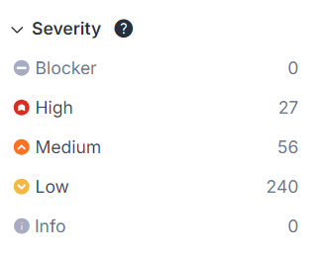
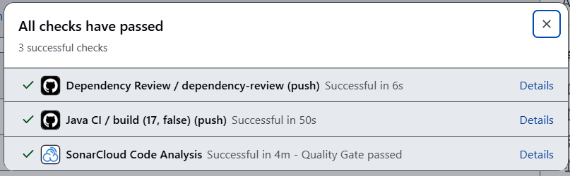
Software quality and ci/cd
SonarCloud was used to conduct a software quality analysis
refactoring
assertions
building
Notes:
SonarCloud was used to conduct a software quality analysis. After solving the issues through refactoring, assertions the project is buildable locally and in GitHub CI/CD

Slide 4
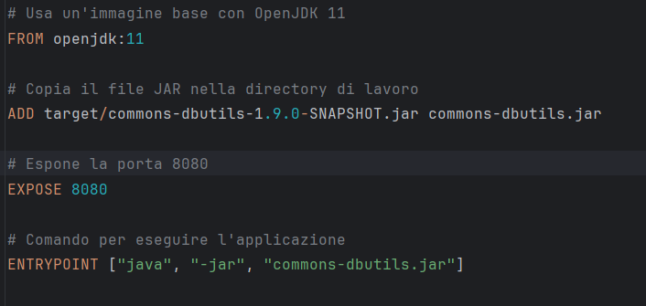


Docker
A Docker image was created from the Dockerfile in the photo
build
run
Docker image
Docker container
Notes:
A docker image was created from the DockerFile in the photo

Slide 5
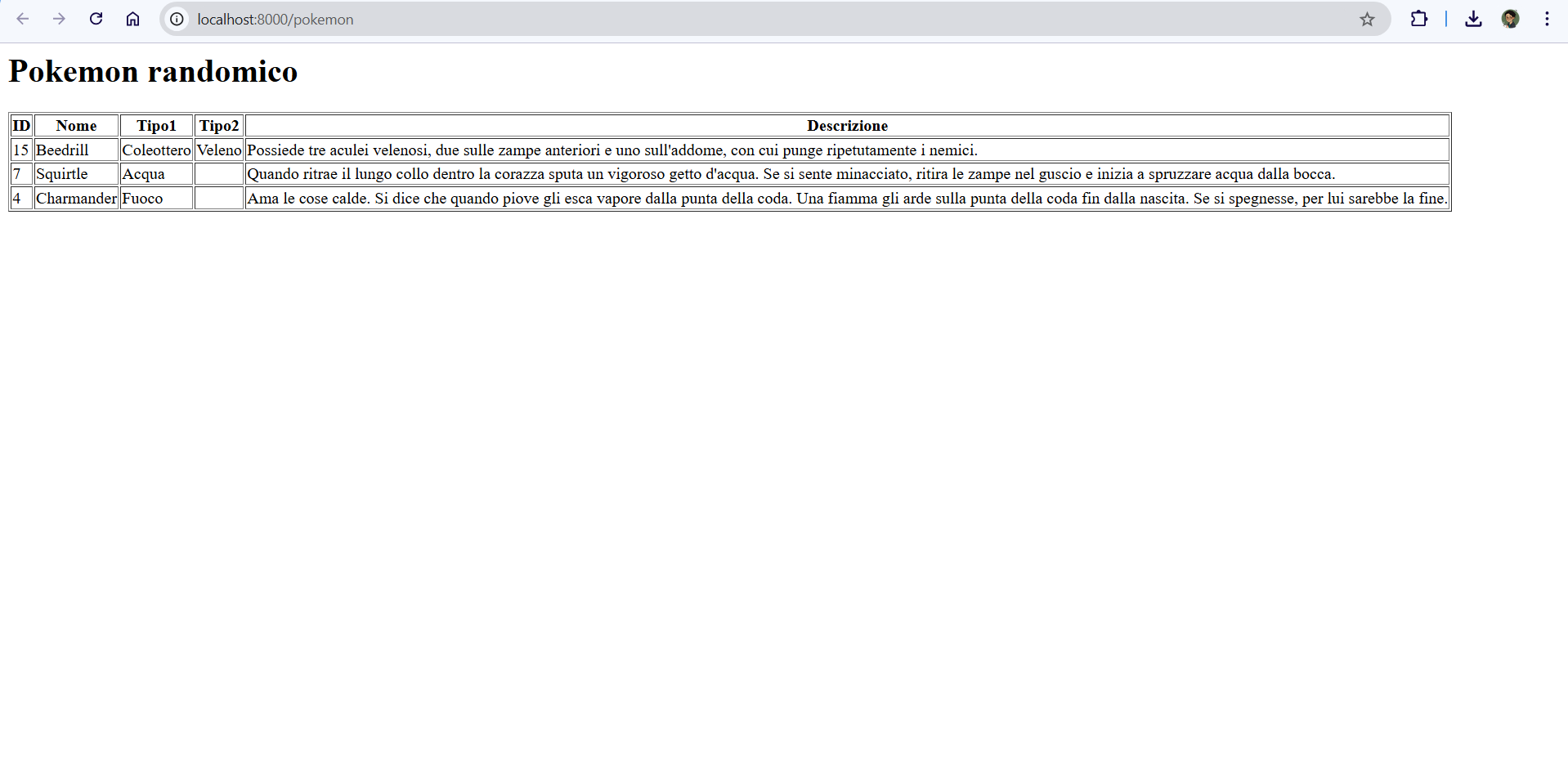





Runnable Container
Notes:
I have created a java web app that uses the dependency of my DbUtils implementation

Slide 6
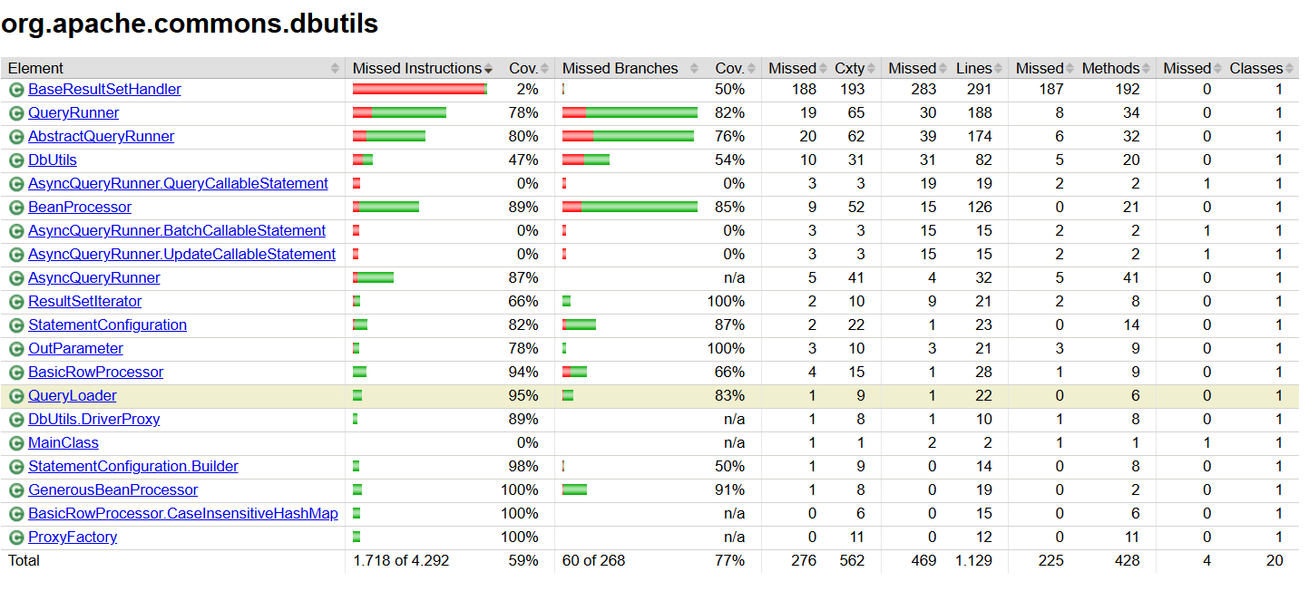
Code coverage
Notes:
I have created a java web app that uses the dependency of my DbUtils implementation

Slide 7
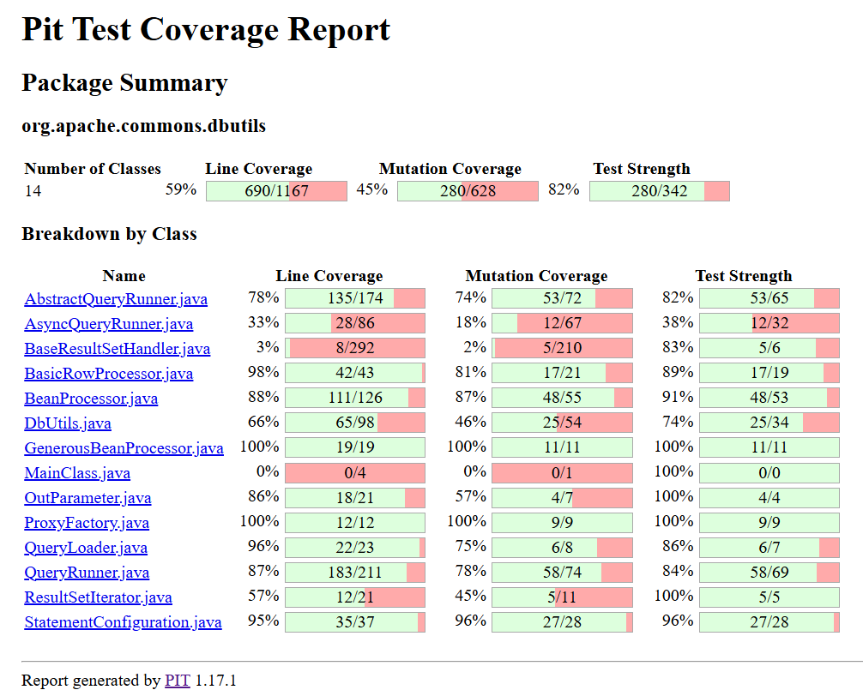
Mutation coverage
Notes:
I have created a java web app that uses the dependency of my DbUtils implementation

Slide 8





Improving Test suites
Instruction coverage
1%
Instruction coverage
Branch coverage
3%
Branch coverage
Mutation Coverage
Test strength
Notes:
I have created a java web app that uses the dependency of my DbUtils implementation

Slide 9


JMH
JMH Dependecies & Plugins + Bechmark Classes
Moditect-maven-plugin failing to generate module-info.java

Slide 10



Vulnerabilities
ERRMSG: possible information exposure through an error message
3 vulnerable dependencies found. All of them are from Randoop-4.3.3, which is the latest version available
SECSQLIJDBC: this use of «method» can be vulnerable to SQL injection
Notes:
Anche dopo aver risolto le SQL Injection le vulnerabilità continuavano a comparire, potrebbe trattarsi di un falso positivo

Slide 11
Grazie per l’attenzione
a.bucci@studenti.unisa.it

